Slide 1
DT DQM Modern Stby test case study

Slide 2
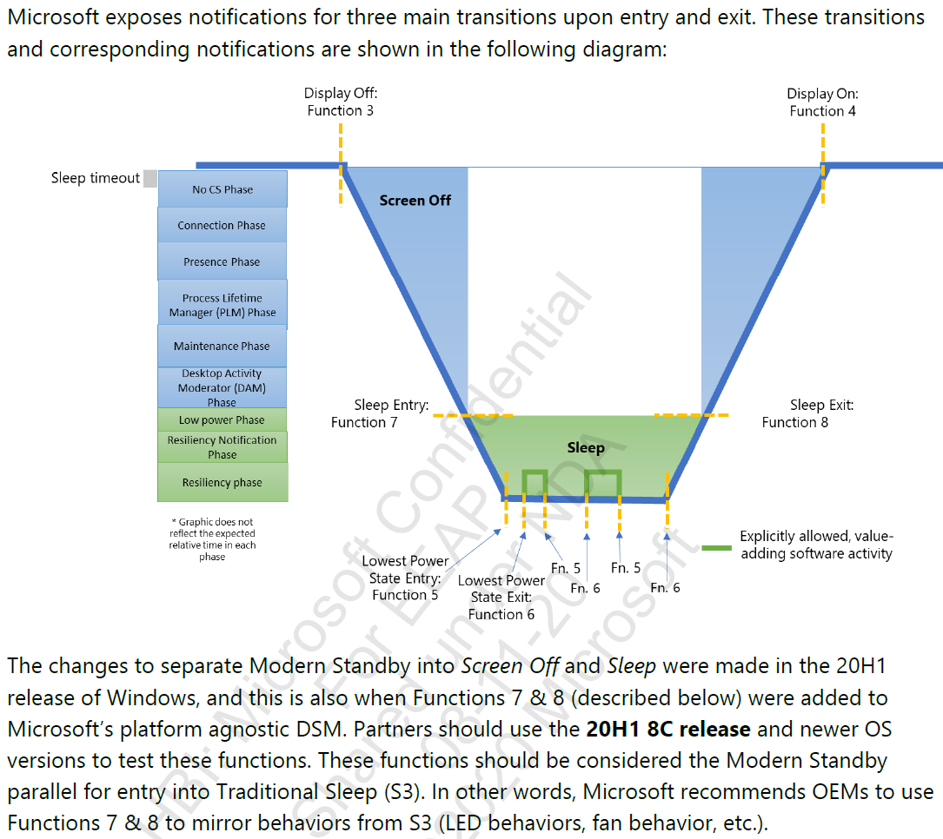
Modern Stby test case study

Slide 3
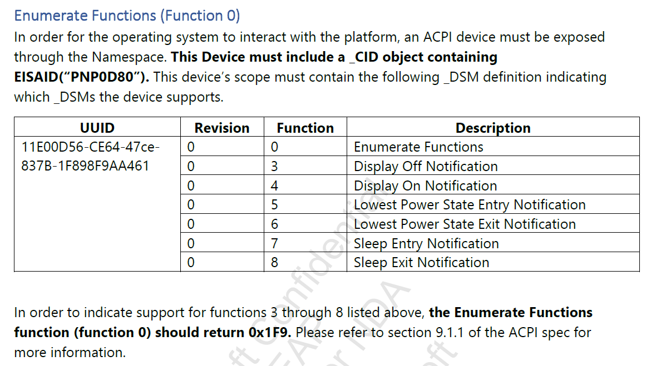
Modern Stby test case study

Slide 4
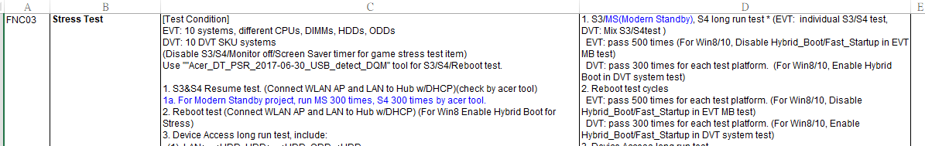
Modern Stby test case study – For DVT and MP/Regression BIOS stress test

Slide 5
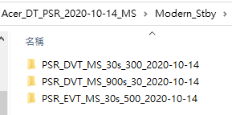
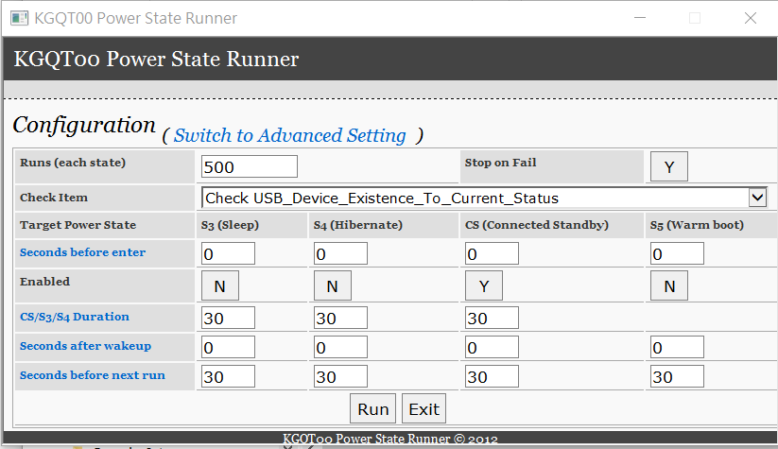
Modern Stby test case study – DQM tool (2012-2020)

Slide 6
Modern Stby test case study – For DVT stress test

Slide 7
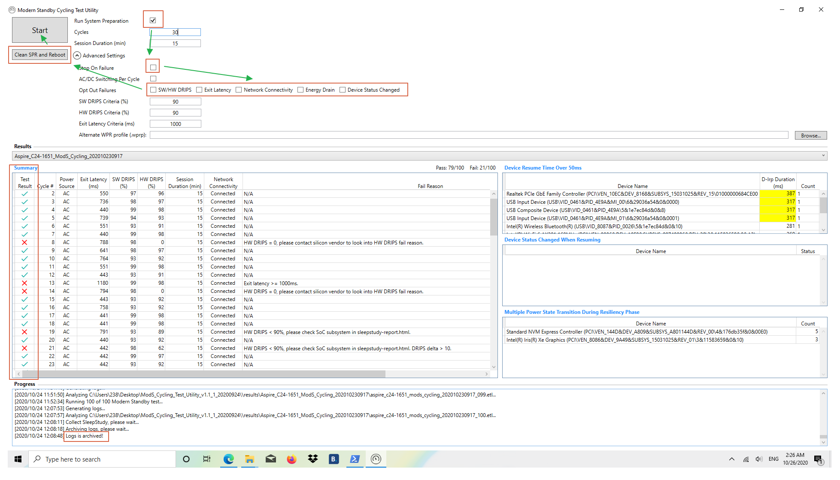
Modern Stby test case study – Microsoft Tool (2020)

Slide 8
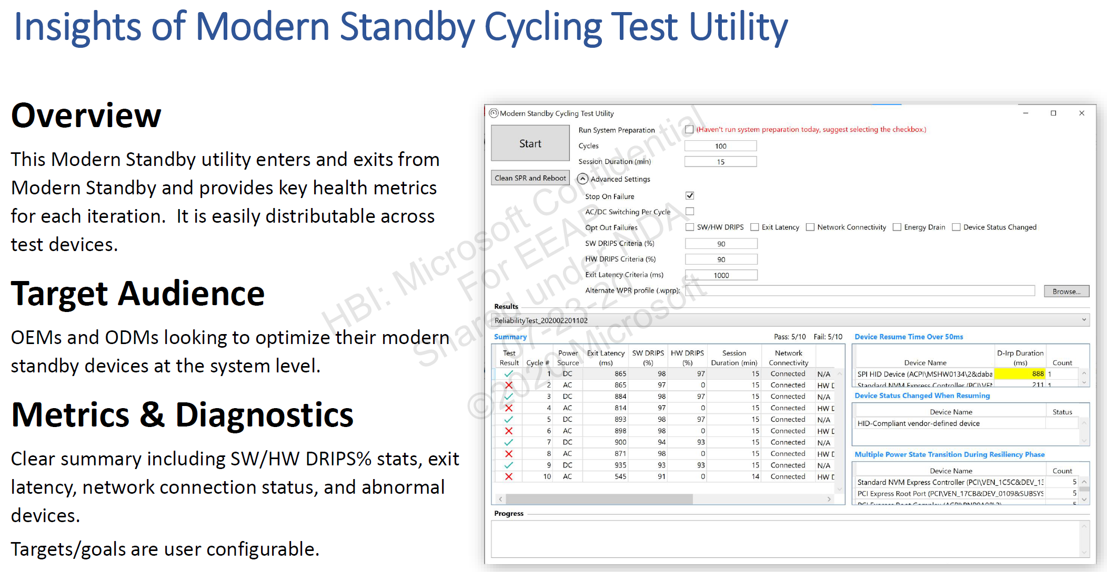
Modern Stby test case study

Slide 9
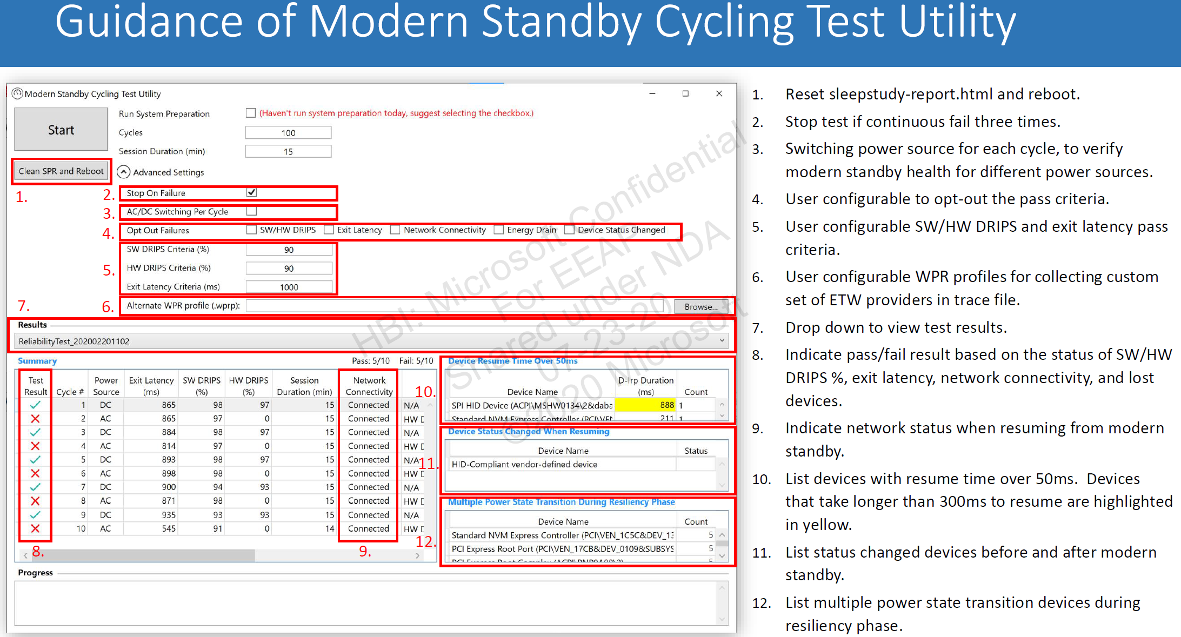
Modern Stby test case study

Slide 10
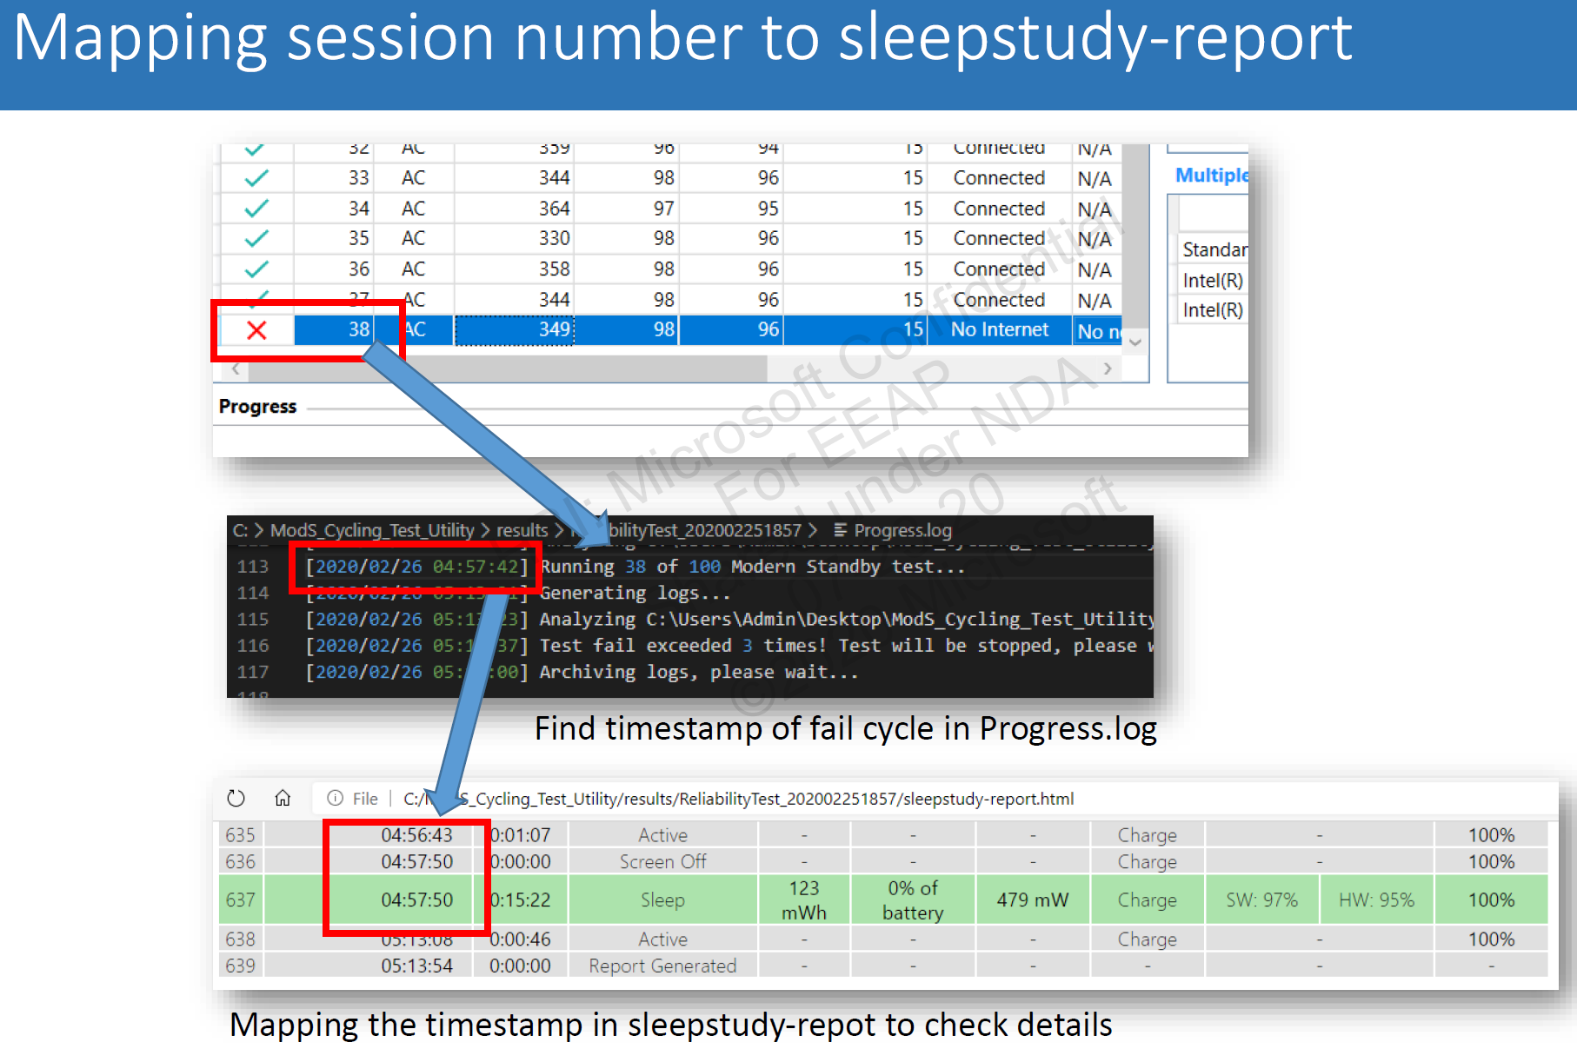
Modern Stby test case study

Slide 11
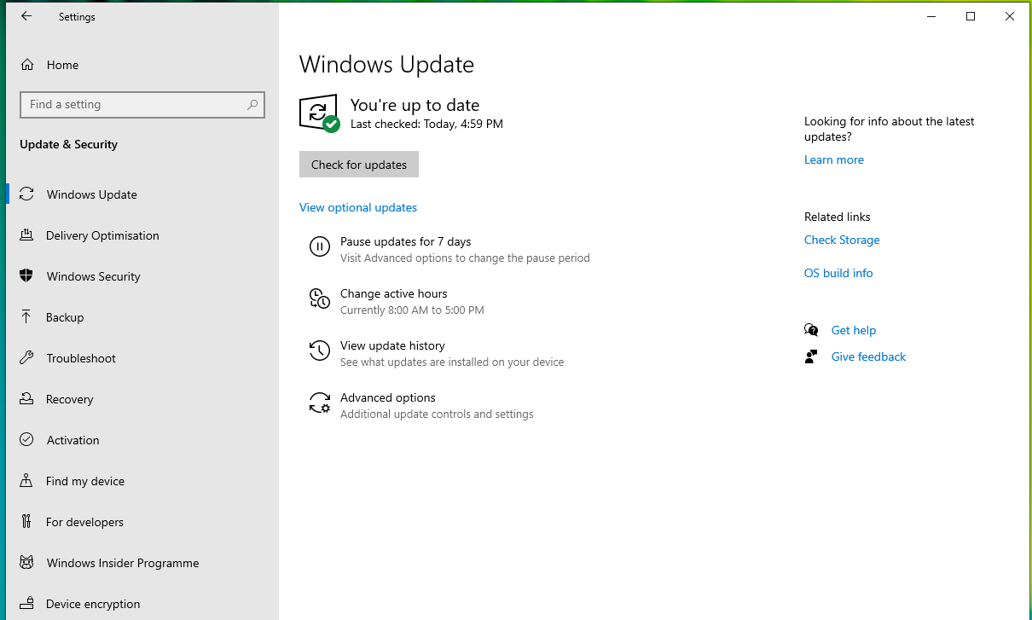
Modern Stby test case study – Finish all WU when LAN/WLAN is connected

Slide 12
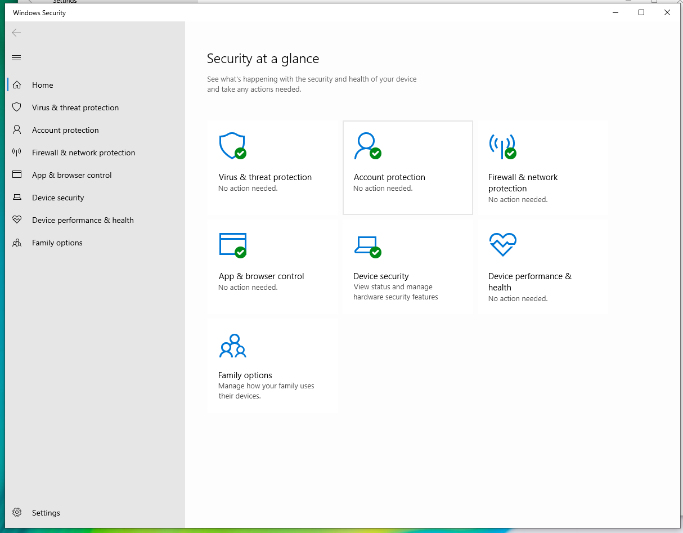
Modern Stby test case study – All item is Green checked

Slide 13
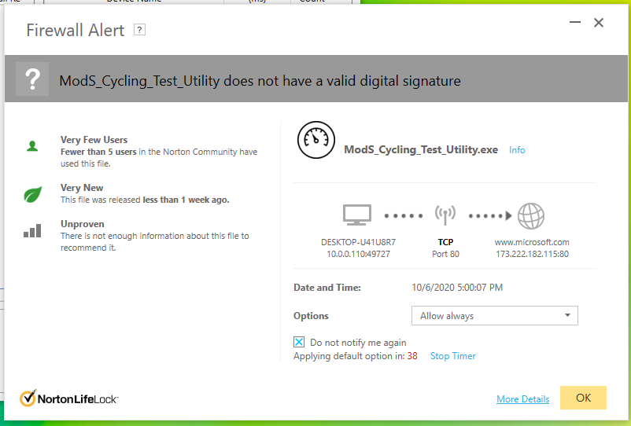
Modern Stby test case study – Finish Norton S/U firewall setup (or remove it)

Slide 14
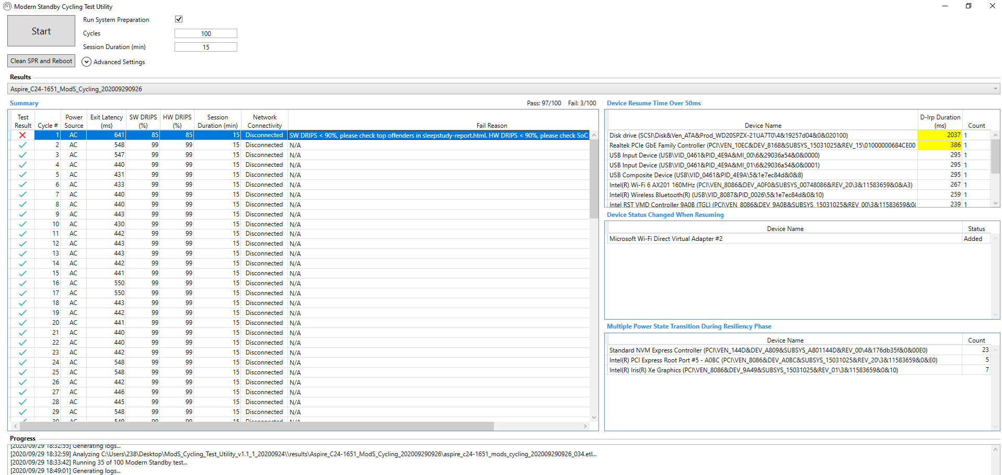
Modern Stby test case study – normal condition during test

Slide 15
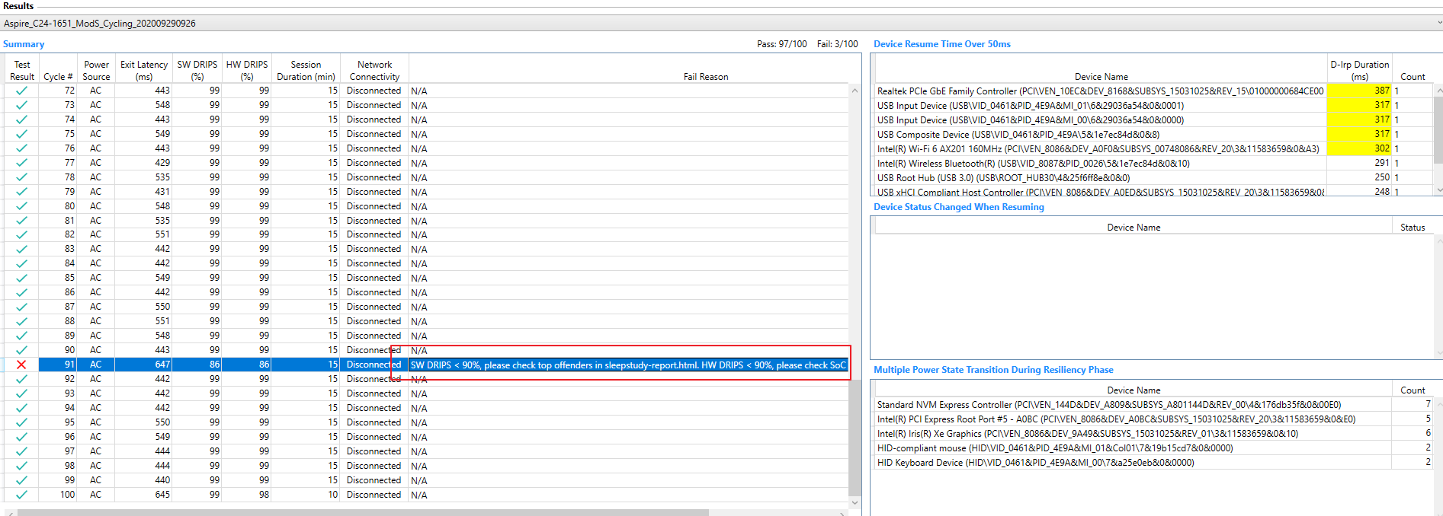
Modern Stby test case study – Random SW(Driver) DRIPS failure

Slide 16
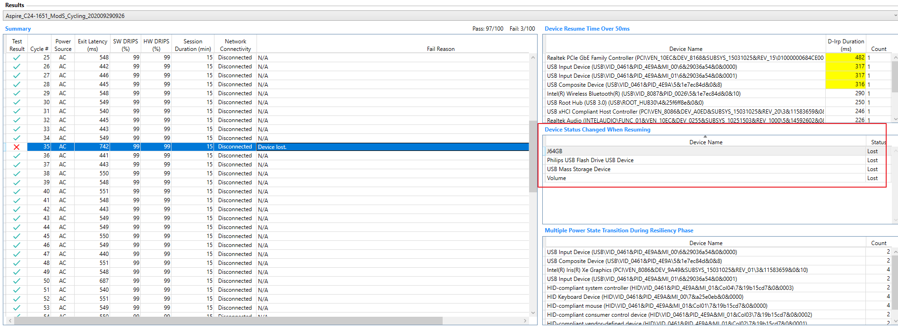
Modern Stby test case study - Device lost during test (intent to remove USB disk, but only log 1 time failure if not install back)

Slide 17
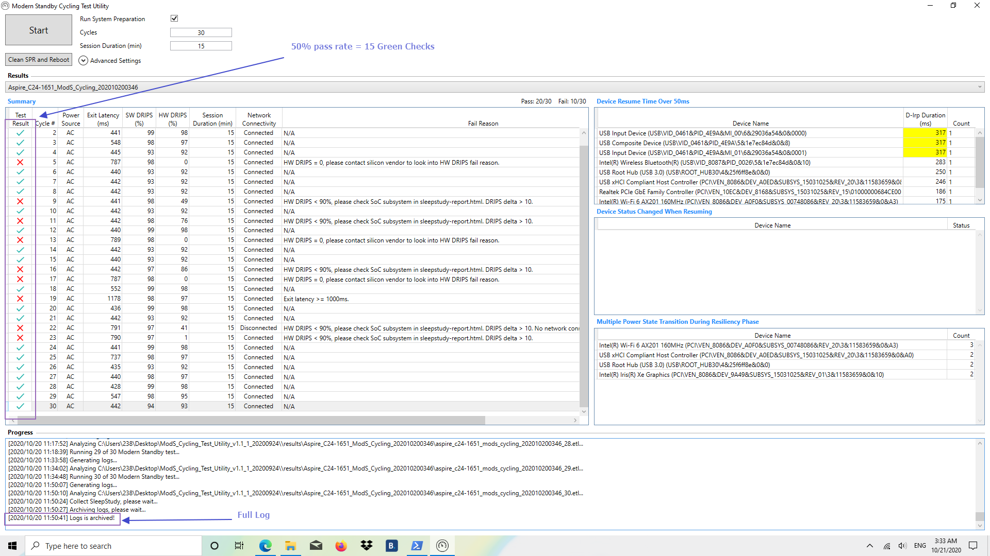
Modern Stby test case study – Log finished – Attach this screen shot to report

Slide 18
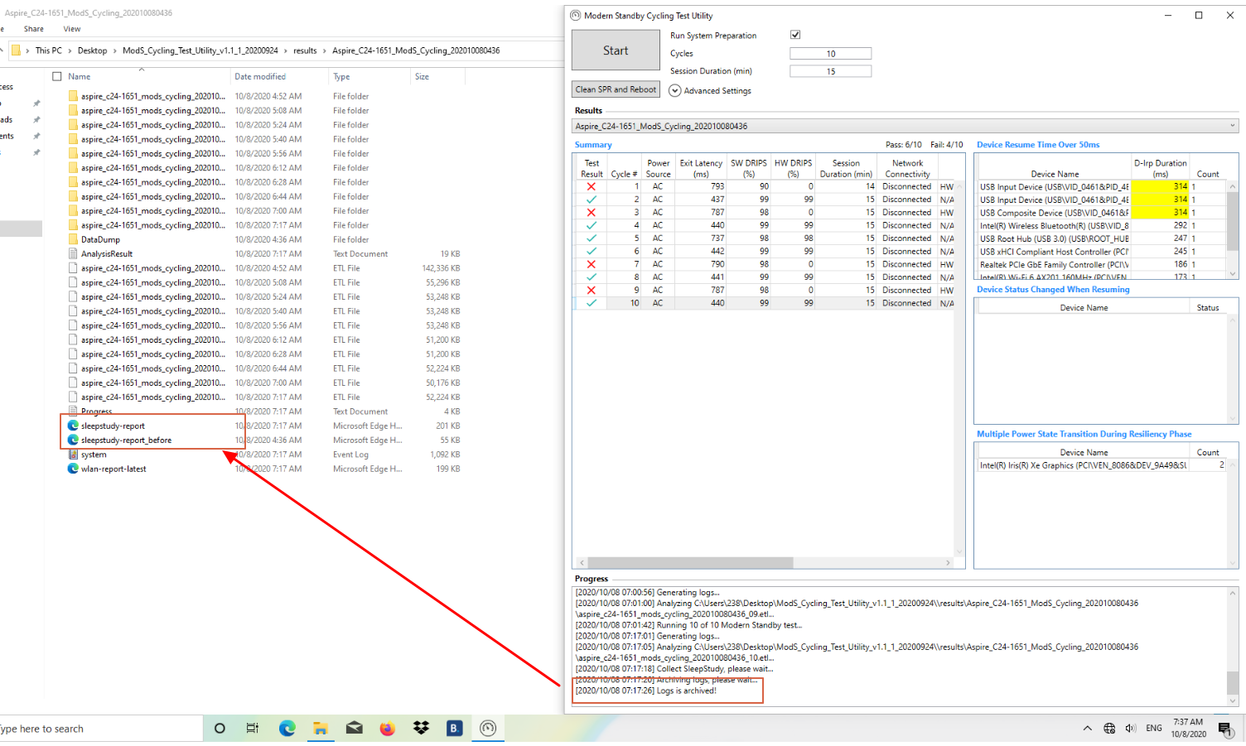
Modern Stby test case study – Log finished – Provide full log file(Zip) to FTP

Slide 19
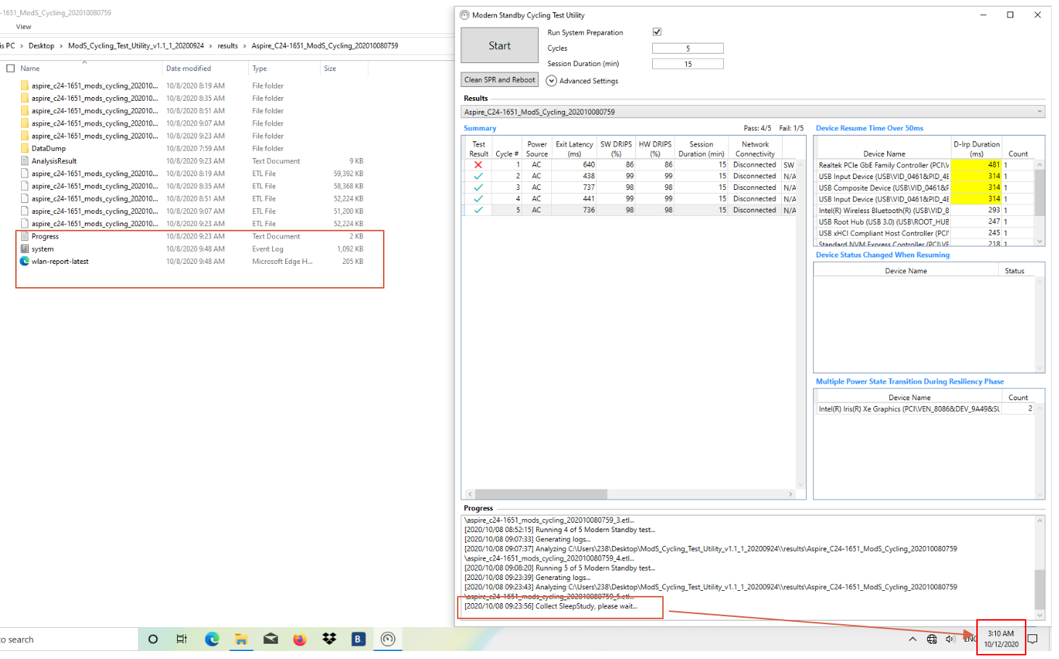
Modern Stby test case study – Log hang up

Slide 20
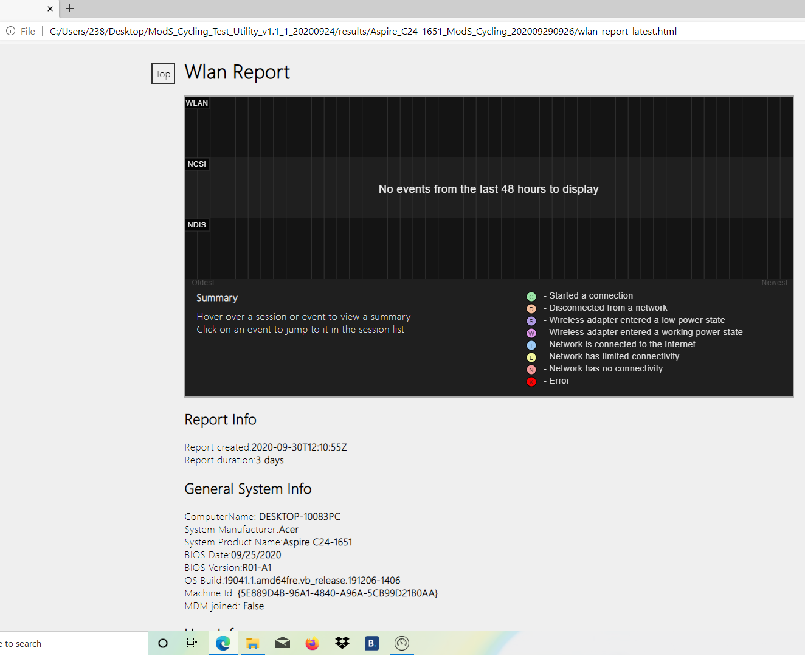
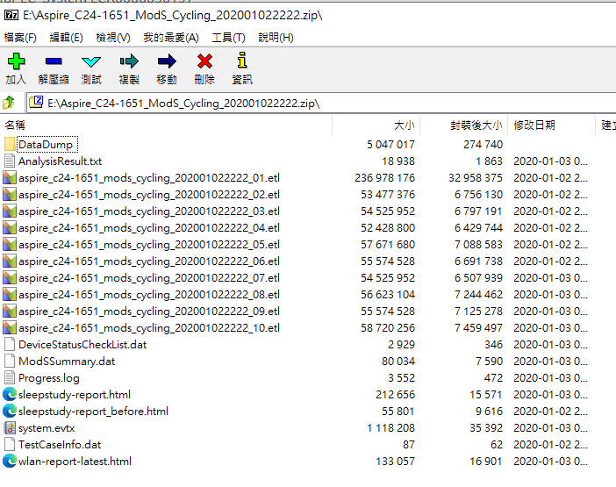
Modern Stby test case study – Auto log for No Wake Up event

Slide 21
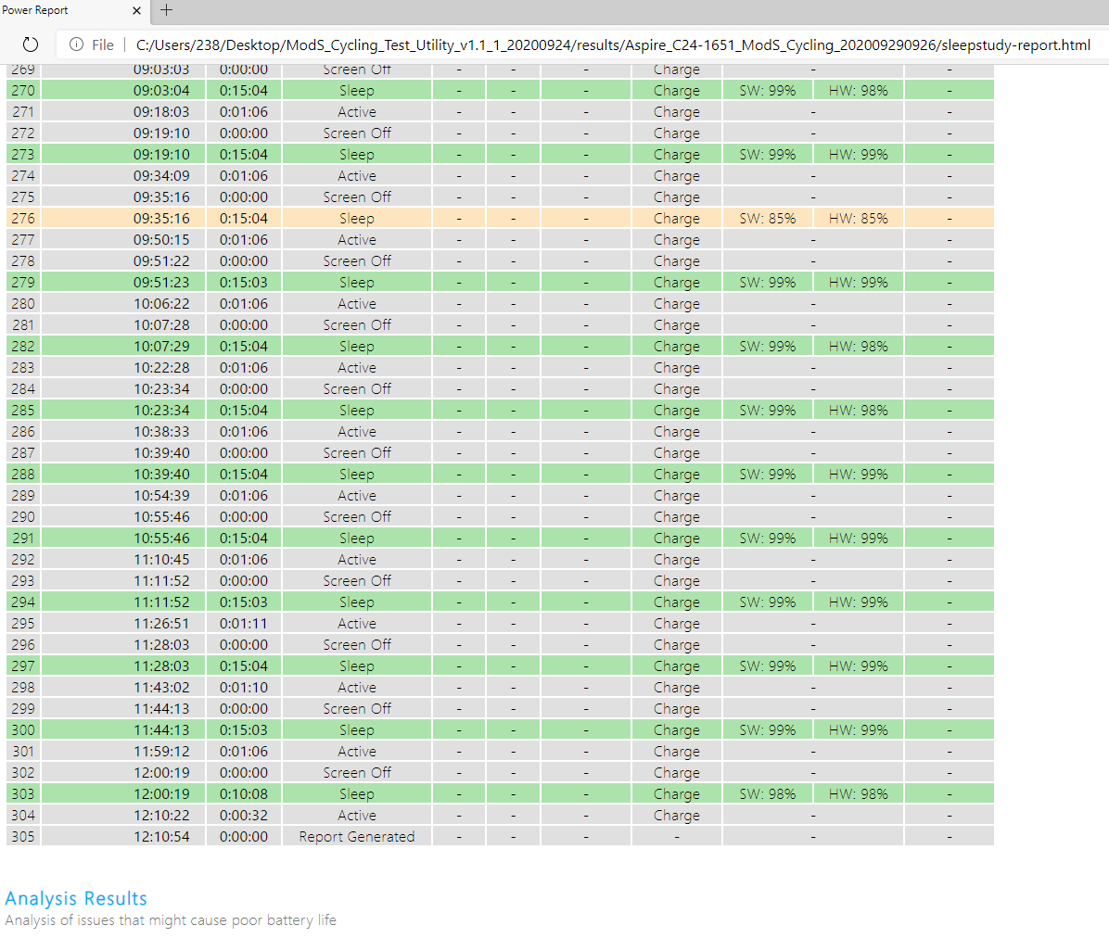
Modern Stby test case study – Random SW/HW DRIPS failure

Slide 22
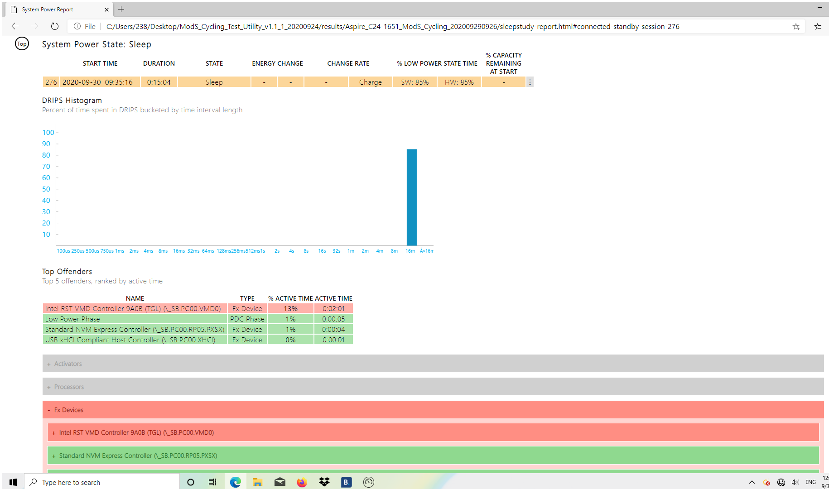
Modern Stby test case study – Sleepstudy
https://docs.microsoft.com/zh-tw/windows-hardware/design/device-experiences/modern-standby-sleepstudy-common-problem-examples

Slide 23
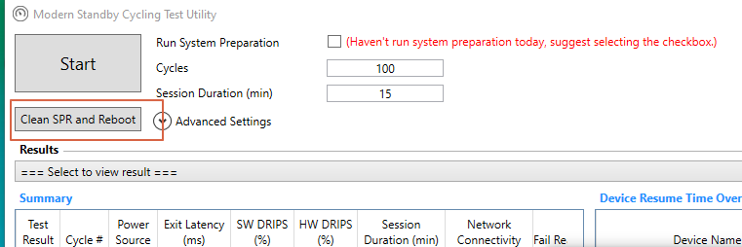
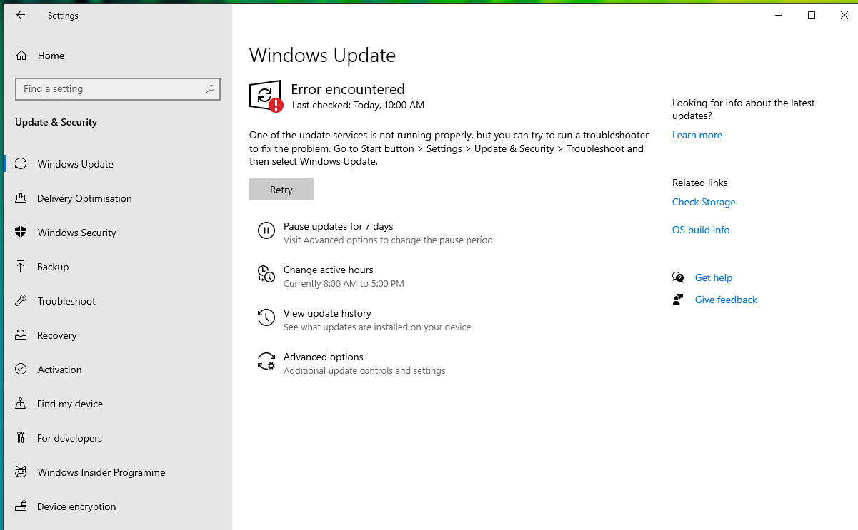
Modern Stby test case study – What would happen if NOT Clean SPR after test finished.

